Slide 1
Database Design in DBMS

Slide 2
Database Design
It is a collection of processes that facilitate the designing, development, and implementation.
Properly designed database are easy to maintain, and are cost effective in terms of disk storage space.
The database designer decides how the data elements correlate and what data must be stored.
Objective: to produce logical and physical designs models of the proposed database system.
The logical model concentrates on the data requirements and the data to be stored independent of physical considerations. It does not concern itself with how the data will be stored or where it will be stored physically.
The physical data design model involves translating the logical DB design of the database into physical media using hardware resources and software systems such as database management systems (DBMS).

Slide 3
Importance of Database Design
It helps to produce database systems:
That meet the requirements of the users
Have high performance.

Slide 4
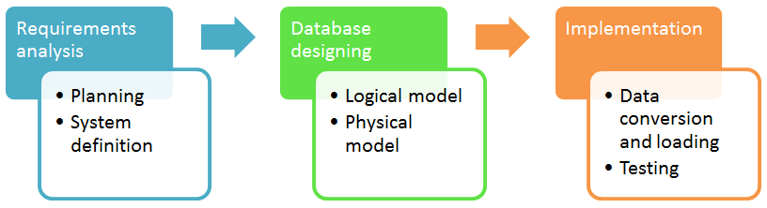
Database development life cycle
1. Requirements analysis:
Planning – This stage of database design concepts are concerned with planning of entire Database Development Life Cycle. It takes into consideration the Information Systems strategy of the organization.
System definition – This stage defines the scope and boundaries of the proposed database system.

Slide 5
Contd…
2. Database designing:
Logical model – This stage is concerned with developing a database model based on requirements. The entire design is on paper without any physical implementations or specific DBMS considerations.
Physical model – This stage implements the logical model of the database taking into account the DBMS and physical implementation factors.
3. Implementation:
Data conversion and loading – this stage of relational databases design is concerned with importing and converting data from the old system into the new database.
Testing – this stage is concerned with the identification of errors in the newly implemented system. It checks the database against requirement specifications.

Slide 6
Contd…
Two Types of Database Design Techniques
1. Normalization
2. ER Modelling

Slide 7
Normalization
It reduces data redundancy and eliminates undesirable characteristics like Insertion, Update and Deletion Anomalies.
Normalization rules divides larger tables into smaller tables and links them using relationships.
The purpose of Normalisation in SQL is to eliminate redundant (repetitive) data and ensure data is stored logically.

Slide 8
KEY in SQL
It is a value used to identify records in a table uniquely.
It is a single column or combination of multiple columns used to uniquely identify rows in the table.
SQL Key is used to identify duplicate information, and it also helps establish a relationship between multiple tables in the database.
Columns in a table that are NOT used to identify a record uniquely are called non-key columns.
Primary Key:
It is a single column value used to identify a database record uniquely.
It has following attributes:
It cannot be NULL
Its value must be unique
Its values should rarely be changed
A composite key is a primary key composed of multiple columns used to identify a record uniquely

Slide 9
Database Normal Forms
List of Normal Forms in SQL:
1NF (First Normal Form)
2NF (Second Normal Form)
3NF (Third Normal Form)
BCNF (Boyce-Codd Normal Form)
4NF (Fourth Normal Form)
5NF (Fifth Normal Form)
6NF (Sixth Normal Form)

Slide 10
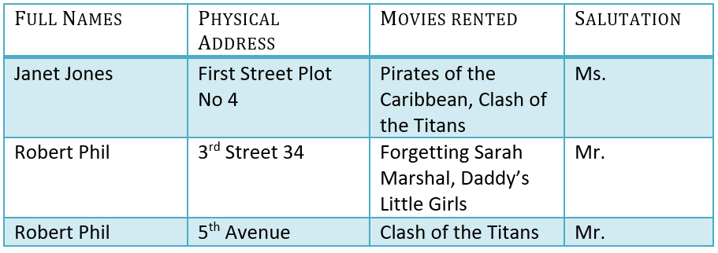
Database Normalization With Examples
Assume, a video library maintains a database of movies rented out. Without any normalization in database, all information is stored in one table as shown below:

Slide 11
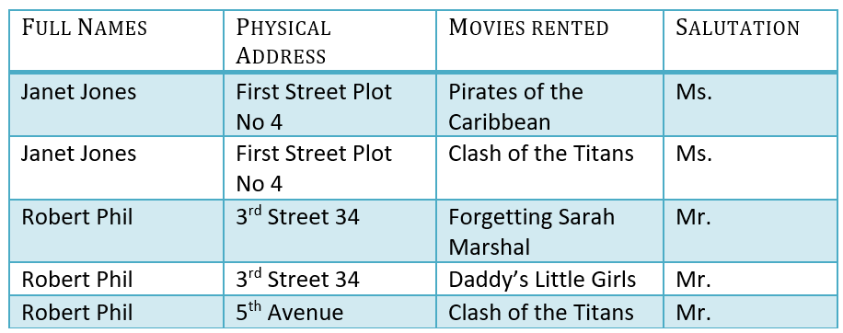
1NF (First Normal Form)
Rules:
Each table cell should contain a single value.
Each record needs to be unique.
Consider previous table in 1NF:

Slide 12

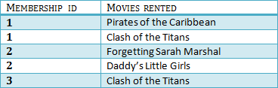
2NF (Second Normal Form)
Rules:
1. Be in 1NF
2. Single Column Primary Key that does not functionally dependant on any subset of candidate key relation
It is clear that we can’t move forward to make our simple database in 2nd Normalization form unless we partition the table above.
In Table 2, Membership ID is the Foreign Key.

Slide 13
Database – Foreign Key
A foreign key can have a different name from its primary key.
It ensures rows in one table have corresponding rows in another.
Unlike the Primary key, they do not have to be unique. Most often they aren’t.
Foreign keys can be null even though primary keys can not.

Slide 14
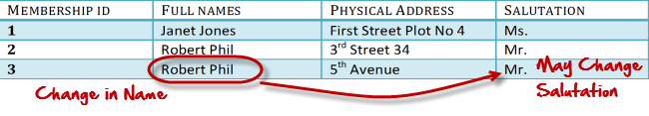
Transitive functional dependencies
It is when changing a non-key column, might cause any of the other non-key columns to change
Consider the table 1, changing the non-key column Full Name may change Salutation.

Slide 15

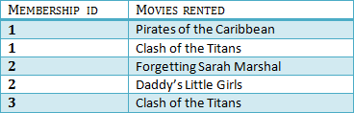

3NF (Third Normal Form)
Rules:
Be in 2NF
Has no transitive functional dependencies
To move our 2NF table into 3NF, we again need to again divide our table.
Below is a 3NF example in SQL database:

Slide 16
Entity Relationship Model (ER Modelling)
It is a graphical approach to database design.
It is a high-level data model that defines data elements and their relationship for a specified software system.
It is used to represent real-world objects.
An Entity is a thing or object in real world that is distinguishable from surrounding environment.
For example, each employee of an organization is a separate entity.
Following are some of major characteristics of entities.
An entity has a set of properties.
Entity properties can have values.

Slide 17
Contd…
E.g.: An employee of an organization is an entity. If “Peter” is a programmer (an employee) at Microsoft, he can have attributes (properties) like name, age, weight, height, etc. It is obvious that those do hold values relevant to him.
Each attribute can have Values. In most cases single attribute have one value. But it is possible for attributes have multiple values also.
For example Peter’s age has a single value. But his “phone numbers” property can have multiple values.
Entities can have relationships with each other.
Assume that each Microsoft Programmer is given a Computer. It is clear that that Peter’s Computer is also an entity. Peter is using that computer, and the same computer is used by Peter. In other words, there is a mutual relationship between Peter and his computer.
In Entity Relationship Modelling, we model entities, their attributes and relationships among entities.

Slide 18
Enhanced Entity Relationship (EER) Model
It is a high-level data model which provides extensions to original Entity Relationship (ER) model.
It supports more details design.
EER Modelling emerged as a solution for modelling highly complex databases.
EER uses UML notation.
UML is the acronym for Unified Modelling Language, it is a general-purpose modelling language used when designing object-oriented systems.
Entities are represented as class diagrams.
Relationships are represented as associations between entities.

Slide 19
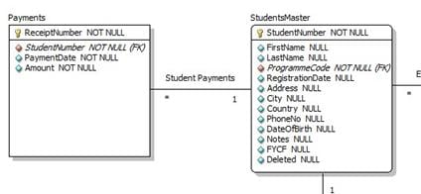
Contd…
The diagram shown below illustrates an ER diagram using the UML notation.

Slide 20
Importance of ER Model
One of the challenges faced when designing a database is the fact that designers, developers, and end-users tend to view data and its usage differently. If this situation is left unchecked, we can end up producing a database system that does not meet the requirements of the users.
Communication tools understood by all stake holders(technical as well as non-technical users) are critical in producing database systems that meet the requirements of the users. ER models are examples of such tools.
ER diagrams also increase user productivity as they can be easily translated into relational tables.

Slide 21
Contd…
Case Study: ER diagram for “MyFlix” Video Library
Let’s now work with the MyFlix Video Library database system to help understand the concept of ER diagrams.
MyFlix is a business entity that rents out movies to its members. MyFlix has been storing its records manually. The management now wants to move to a DBMS
Let’s look at the steps to develop EER diagram for this database:
Identify the entities and determine the relationships that exist among them.
Each entity, attribute, and relationship, should have appropriate names that can be easily understood by the non-technical people as well.
Relationships should not be connected directly to each other. Relationships should connect entities.
Each attribute in a given entity should have a unique name.

Slide 22
Contd…
Entities in the “MyFlix” library
The entities to be included in our ER diagram are;
Members – this entity will hold member information.
Movies – this entity will hold information regarding movies
Categories – this entity will hold information that places movies into different categories such as “Drama”, “Action”, and “Epic” etc.
Movie Rentals – this entity will hold information that about movies rented out to members.
Payments – this entity will hold information about the payments made by members.

Slide 23
Defining the Relationships Among Entities:
1. Members and movies
The following holds true regarding the interactions between the two entities.
A member can rent more than one movie in a given period.
A movie can be rented by more than one member in a given period.
From the above scenario, we can see that the nature of the relationship is many-to-many. Relational databases do not support many-to-many relationships. We need to introduce a junction entity. This is the role that the MovieRentals entity plays. It has a one-to-many relationship with the members table and another one-to-many relationship with movies table.

Slide 24
Contd…
2. Movies and categories entities
The following holds true about movies and categories.
A movie can only belong to one category but a category can have more than one movie.
We can deduce from this that the nature of the relation between categories and movies table is one-to-many.
3. Members and payments entities
The following holds true about members and payments
A member can only have one account but can make a number of payments.
We can deduce from this that the nature of the relationship between members and payments entities is one-to-many.

